Slide 1

CSCI 232: Data Structures and Algorithms
Shortest Path (Part 2)
Reese Pearsall
Spring 2024
https://www.cs.montana.edu/pearsall/classes/spring2024/232/main.html

Slide 2
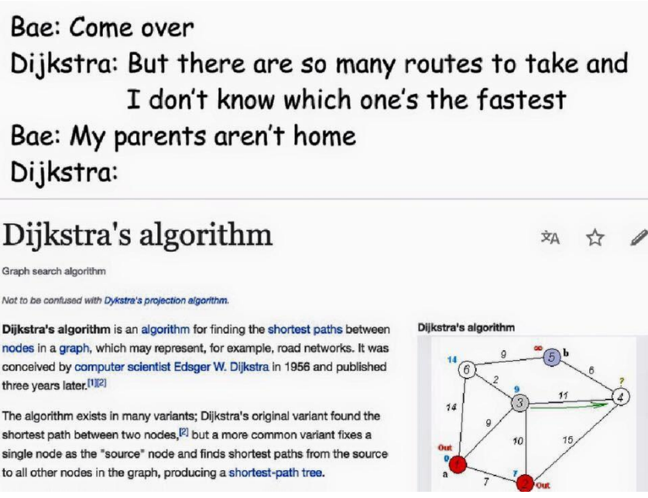
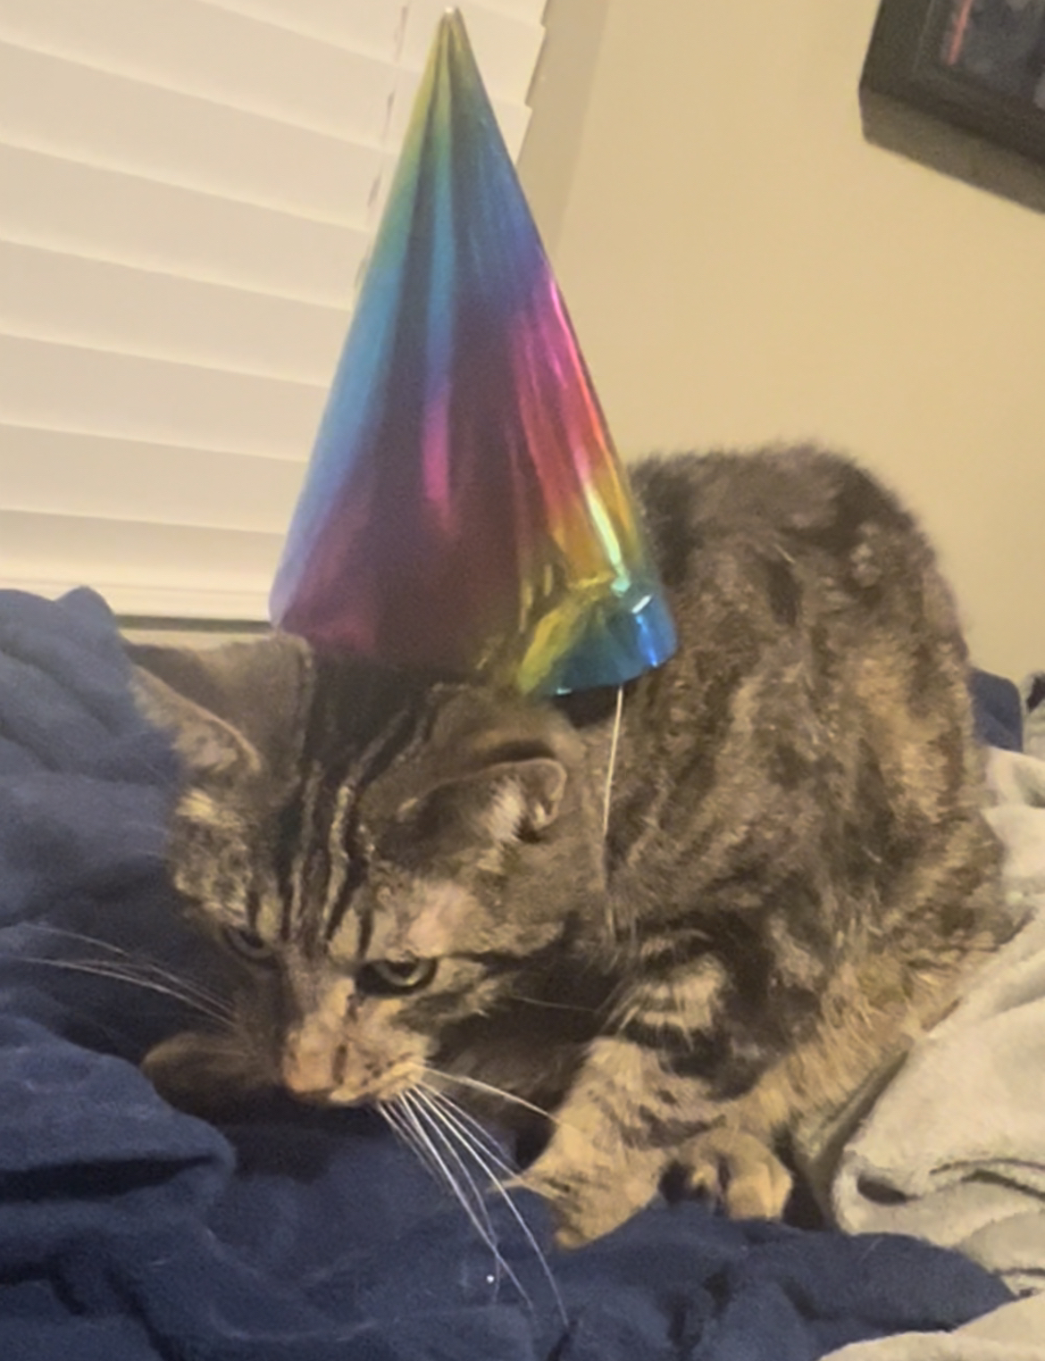
Announcements
Lab 10 due Sunday at 11:59 PM
(Part 1 of Program 3)
Yes, there will be a program 4 (but it will be easier)

Slide 3
Lab 10
3

Slide 4
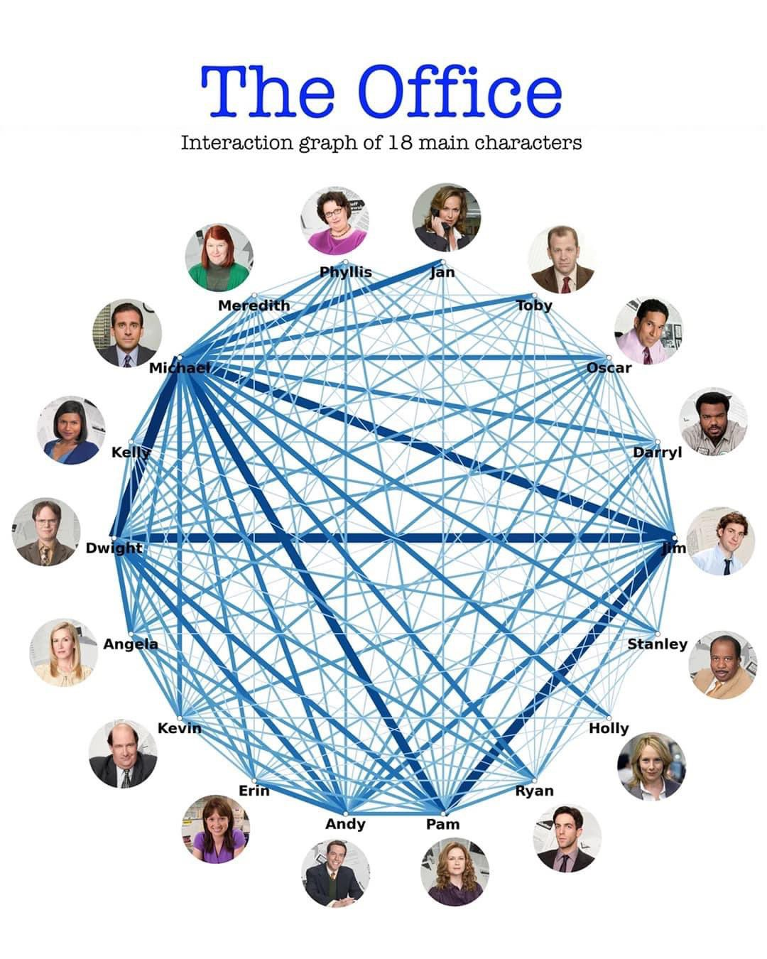
4

Slide 5
https://youtu.be/EFg3u_E6eHU
5

Slide 6
Dijkstra’s Algorithm
Distance from 0
Previous vertex
Priority queue
0.22
1
0.29
0 | 0
1 | 0.92
2 | 0.26
3 | 0.99
4 | 0.38
5 | 0.70
6 | 1.51
7 | 0.60
0 | -
1 | 5
2 | 0
3 | 7
4 | 0
5 | 7
6 | 3
7 | 2
5
3
0.1
0.39
0.28
7
0.34
0.35
2
0.52
0.37
0.26
0.35
0
0.4
0.38
0.58
4
6
0.93
Rule: When processing vertex v, only add/modify queue for neighbor u if and only if: distance[v] + weight(v, u) < distance[u]
vertex (distance)
6

Slide 7
u₁
0.22
1
0.29
u₂
Distance from 0
Previous vertex
Priority queue
5
3
0.1
v
0.39
0.28
7
0 | 0
1 | ∞
2 | 0.26
3 | 0.99
4 | 0.38
5 | 0.73
6 | ∞
7 | 0.60
0 | -
1
2 | 0
3 | 7
4 | 0
5 | 4
6
7 | 2
5 (0.73)
0.34
0.35
2
0.52
0.37
0.26
3 (0.99)
0.35
0
0.4
0.38
0.58
4
6
0.93
Rule: When processing vertex v, only add/modify queue for neighbor u if and only if: distance[v] + weight(v, u) < distance[u]
vertex (distance)
PriortityVertex
Objects
0.60 + 0.1 < 0.73
7

Slide 8


u₁
0.22
1
0.29
u₂
Distance from 0
Previous vertex
Priority queue
5
3
0.1
v
0.39
0.28
7
0 | 0
1 | ∞
2 | 0.26
3 | 0.99
4 | 0.38
5 | 0.73
6 | ∞
7 | 0.60
0 | -
1
2 | 0
3 | 7
4 | 0
5 | 4
6
7 | 2
5 (0.73)
0.34
0.35
2
0.52
0.37
0.26
3 (0.99)
0.35
0
0.4
0.38
0.58
5 (0.70)
4
6
0.93
0.70
7
Rule: When processing vertex v, only add/modify queue for neighbor u if and only if: distance[v] + weight(v, u) < distance[u]
vertex (distance)
PriortityVertex
Objects
8

Slide 9
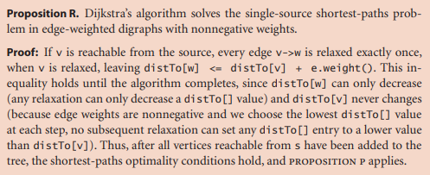

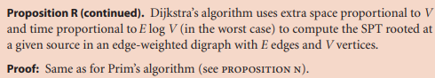
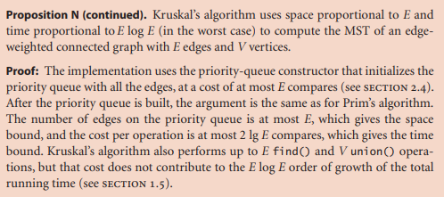
Dijkstra’s Algorithm
Running Time: O(E ⋅ log(V))*
E = # of edges
V = # of vertices
* Varies depending on implementation and representation
Edsger Wybe Dijkstra
11 May 1930 – 6 August 2002
9

Slide 10
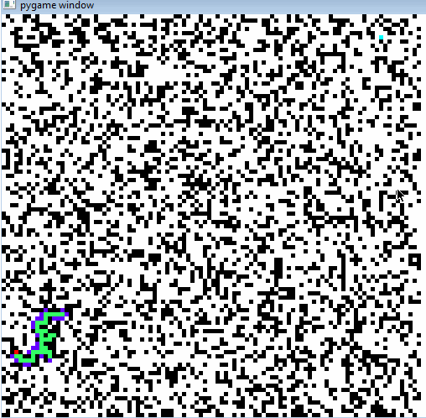
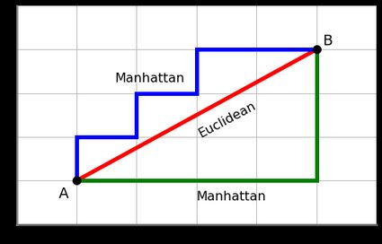
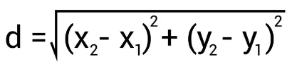
A Star
A Star or A* is another algorithm that will compute the shortest path in a graph
In Dijkstra’s Algorithm we select the least-cost unvisited node, and we compute the shortest path to all other nodes
In A*, we select the node that is the shortest distance away from the target, and does not compute the shortest path to all other nodes
In A* we use a heuristic to make decisions
Euclidean Distance heuristic
(No difference in running time)
10

Slide 11
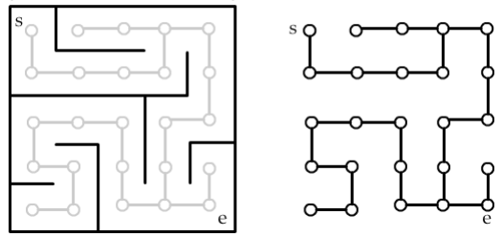
We can represent a maze using graphs!
11

Slide 12
Creating Mazes with Depth First
https://www.youtube.com/watch?v=e5zDG4JIsyg
12

Slide 13
Shortest Path Algorithms on Maze
https://clementmihailescu.github.io/Pathfinding-Visualizer/
13

Slide 14
Applications of Shortest Path?
14

Slide 15
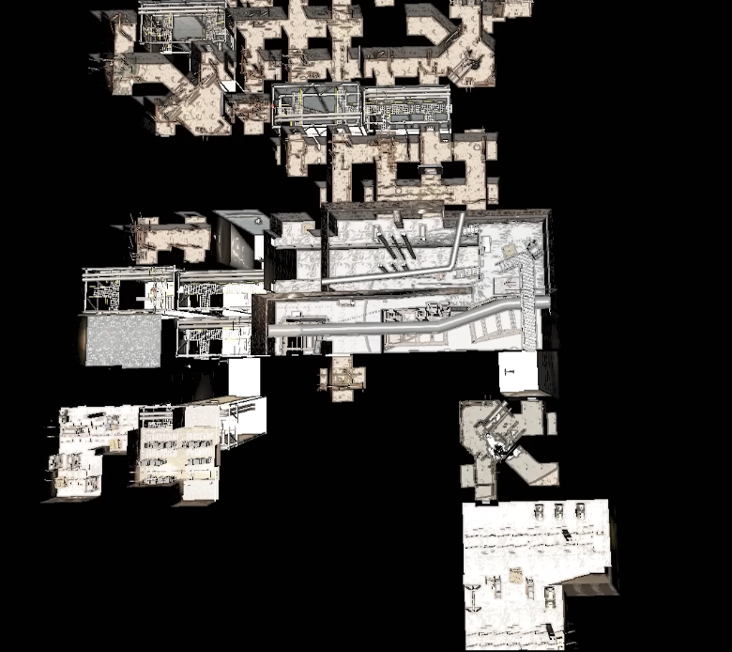
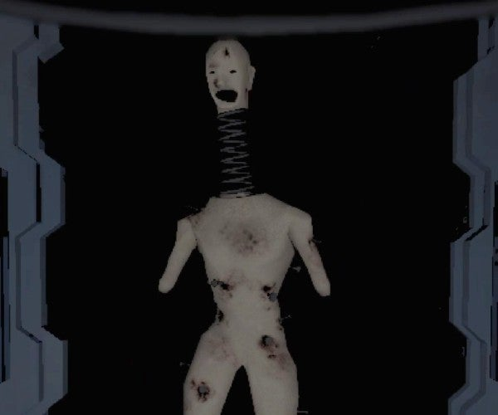
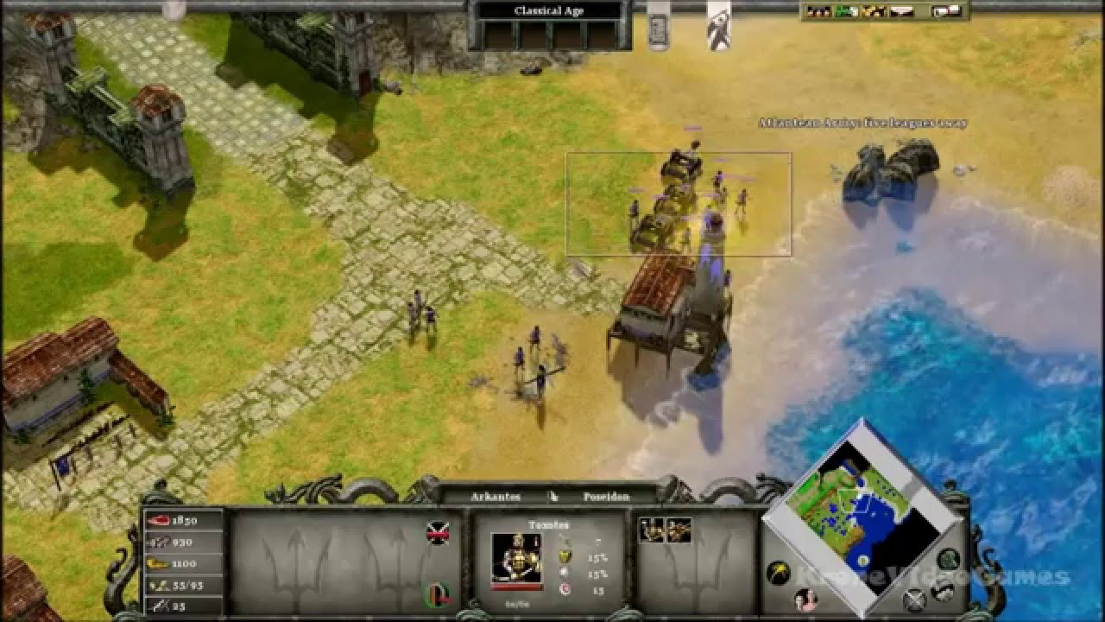
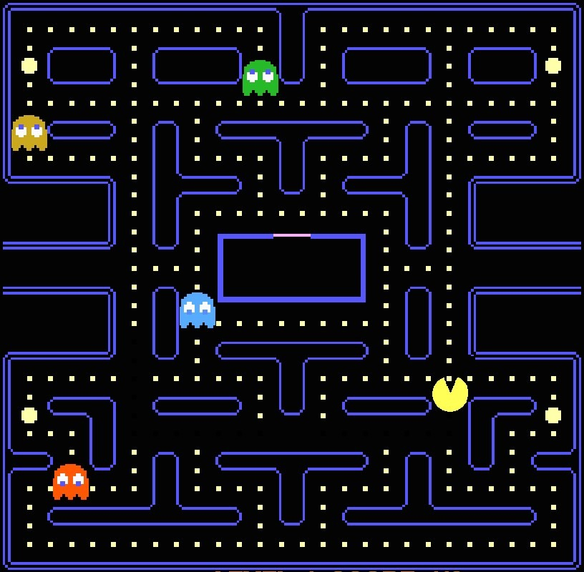
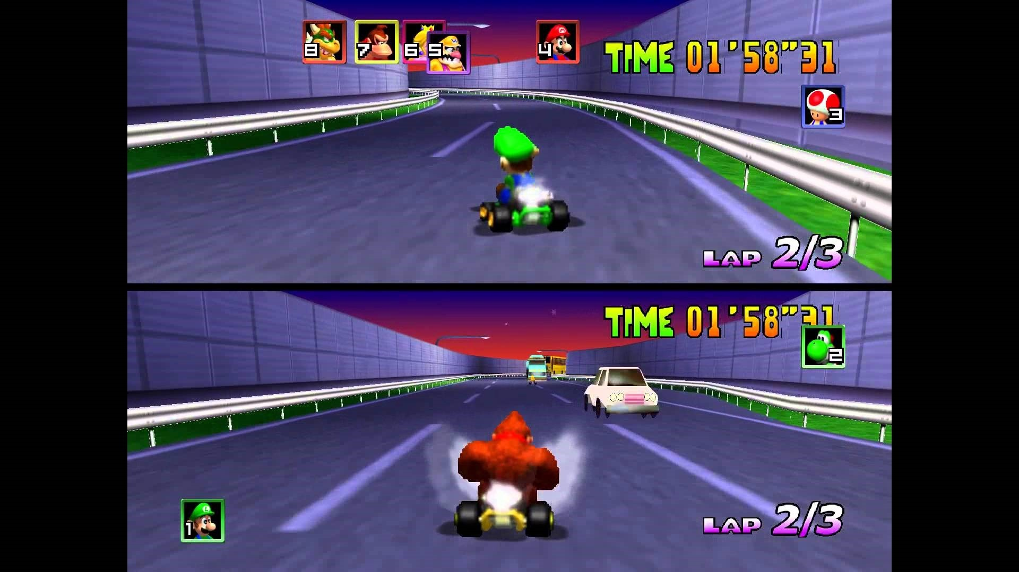
15

Slide 16

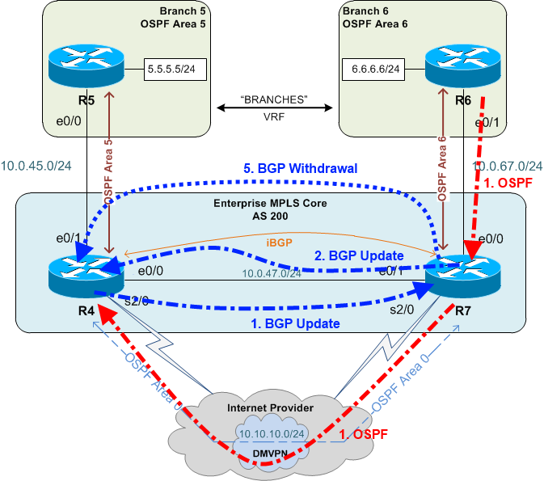
Dijkstra’s Algorithm is used for network routing
The OSPF Protocol
16

Slide 17
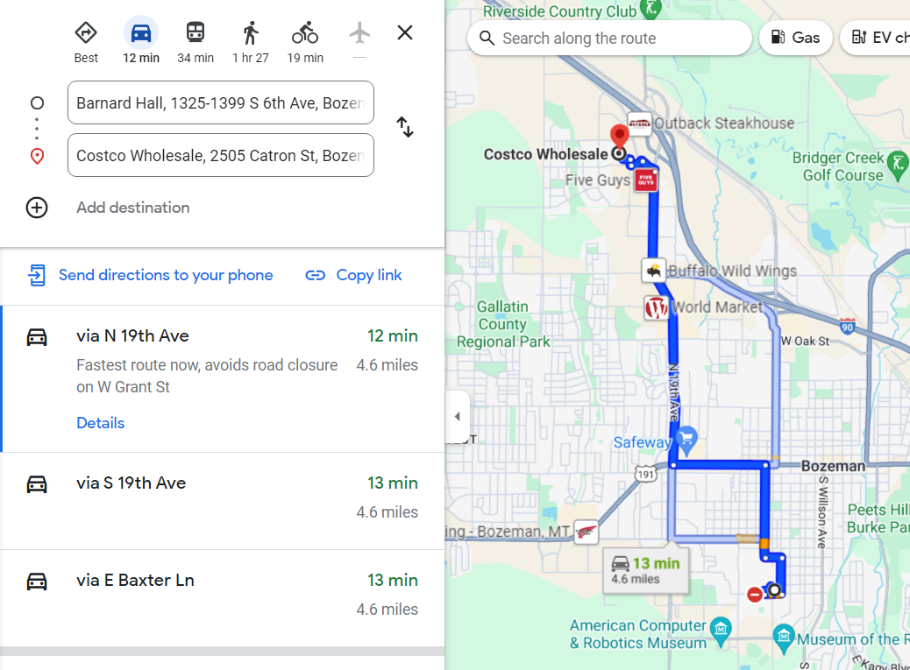
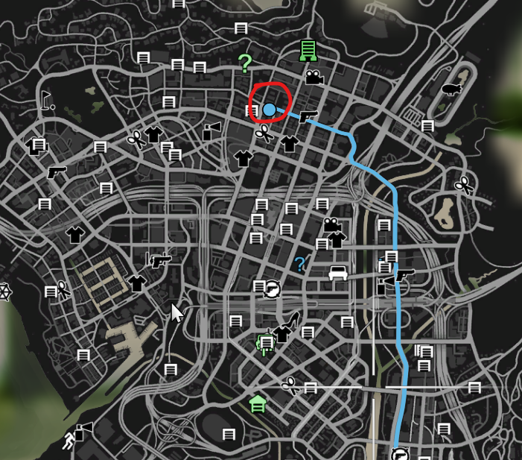
Finding shortest path on a map
17

Slide 18

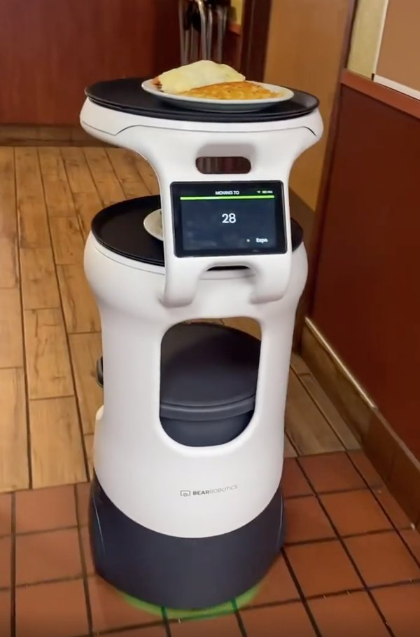
Sending drones or robots on the shortest path
18

Slide 19
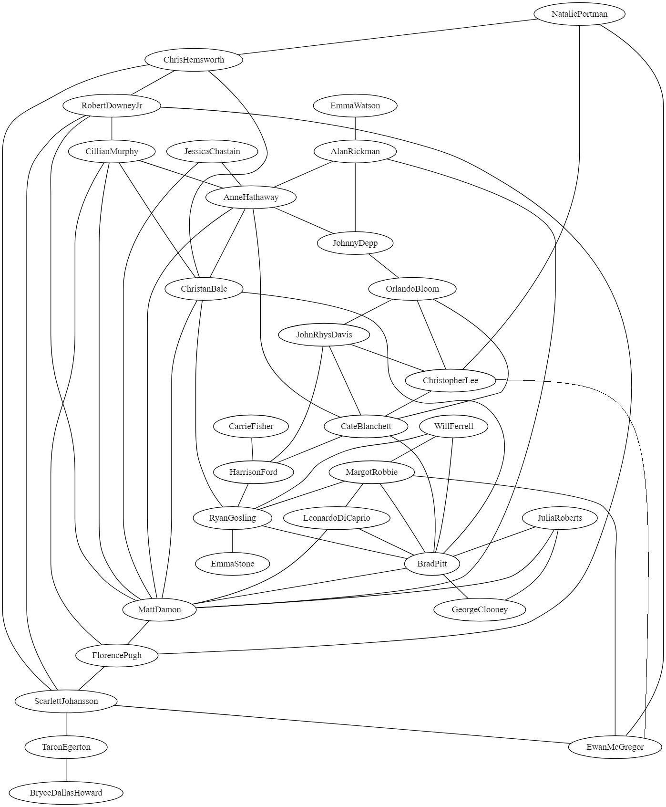
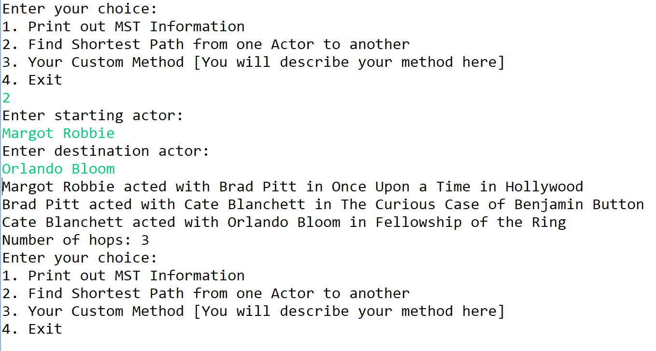
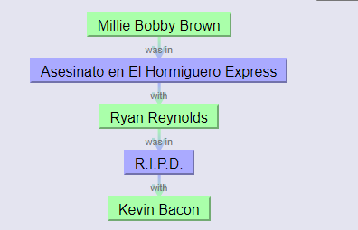



Finding Shortest Path between actors
Oracle of Bacon
19

Slide 20
Program 3
* And MST tree
20

Slide 21
Readability and Coding Style
21

